Slide 1
Chapter Three
The Hidden Core of Culture
By Xiang Qizheng
Apr. 25th,2024

Slide 2

Contents for Chapter Three
1
Warm- up
2
The Axial Age & Cultural Spirits
3
History, Worldviews & Values
4
Review and Reflection

Slide 3
Warm-up
Read Case A on Page 35 and discuss with your group members why the husband and wife behaved differently? Can you explain from the perspective of values?

Slide 4
Warm-up
Refer to the different value types on Page 52 and figure out which value(s) is/are concerned with.

Slide 5
Warm-up
individual, privacy, freedom, thrift/frugality…

Slide 6
So it is easier to understand why westerners do not like to talk about one’s income, healthy conditions especially illness, age, marital status, etc.
Privacy

Slide 7
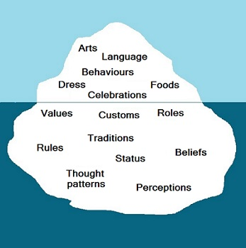
The core part of culture includes things like perceptions, views, beliefs, values, attitudes, tradition...
All these are abstract and invisible.
However, we can observe people’s behaviors and actions which reflect their values.
What is the hidden core of culture?

Slide 8
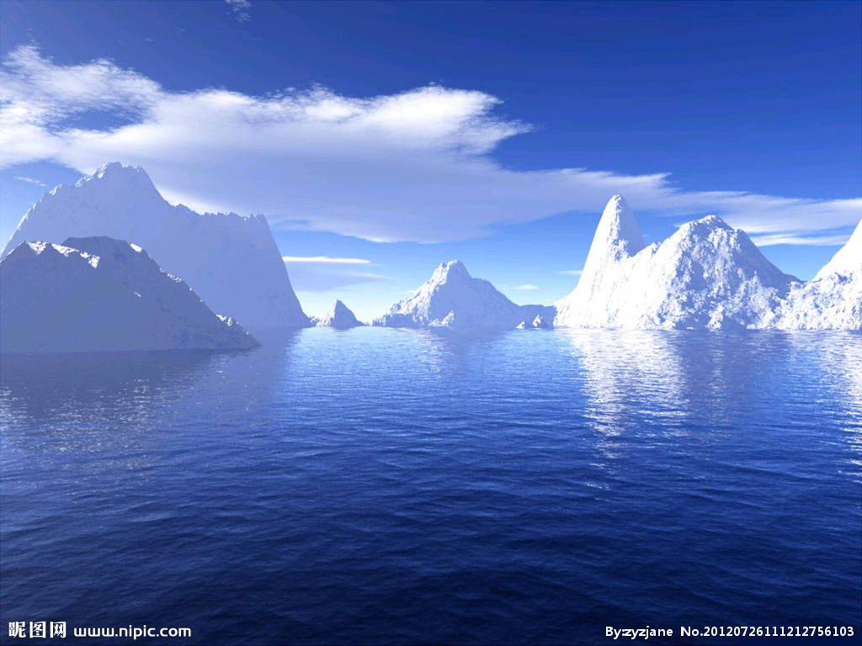
Which one of the following belongs to “the hidden core” of culture?
Architecture
Paintings
Attitudes
Literature

Slide 9
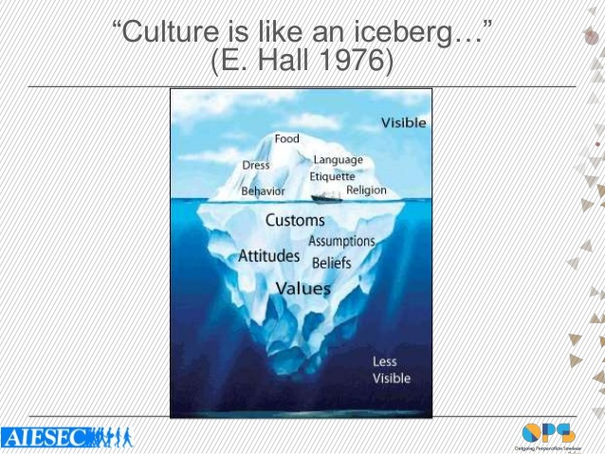
Culture Like an Iceberg (P.14)
a. Visible culture:
food, dress, paintings, architecture, languages, history, literature.
( visible, small part)
b. Invisible culture:
feelings, attitudes, views, beliefs, values, customs.
(invisible, large part )

Slide 10
II. Recognizing Key Elements in the Core of Culture
1) the Axial age and the different cultural spirits
2) Worldviews—it produces great effects on the social, economic, and political life of a nation.
Holistic vs. dualistic worldviews-Eastern and
Western view.
3) Values (orientations & dimensions) /ˌɔːriənˈteɪʃn/
/daɪˈmenʃn/, /dɪˈmenʃn/

Slide 11
II. Recognizing Key Elements in the Core of Culture
In this part, our main purpose is to foster cultural and intercultural awareness, and develop a general picture of culture so as to better conduct communication across cultures, facilitate mutual understanding, and achieve peaceful coexistence of different peoples. Therefore, we will just focus on history, worldviews and values. History is the soil where a culture’s myriad of ideas grows. The worldview usually underlies the values shared by members of a culture, which are closely related to history, tradition, attitudes, beliefs, practices and institutions.
myriad[ˈmiriəd] 无数；极大数量

Slide 12
Karl Jaspers—Axial Age
The Origin and Goal of History—provides an interesting frame of reference for us to have some ideas about the founding of ancient philosophy and religion. (P.37)
Knowledge of ancient philosophies and religions is indispensable in the understanding of cultures.

Slide 13
The Axial Age P.37
What is the Axial Age?
Which time period does it refer to?
Why do we call it the Axial Age?

Slide 14
The Axial Age
The Axial Age is a historical period from 800BC to 200BC, during which, great minds appeared almost simultaneously in the Eastern and Western World.
“轴心时代”或“轴心期"概念是德国思想家卡尔·雅斯贝尔斯在《历史的起源与目标》一书中明确提出的一个跨文化研究的概念，用以指称公元前500年前后即公元前800年至公元前200年间同时出现在中国、西方和印度等地区的文化突破现象。

Slide 15
The Axial Age
Each culture is like a stream which flows from its source.
The source plays an essential part in determining the specific spirit of culture.
The source should never be neglected in our study of culture.

Slide 16
The Axial Age---Great Minds
Ancient China, Lao Tze; Confucius; Mo Tze
Ancient India, Siddhartha Gautama (Sakyamuni)
Ancient Greece, Homer; Socrates; Plato; Aristotle
Confucianism, Taoism, Legalism and Mohism
Han Feizi

Slide 17
The Axial Age---Great Minds
Legalism:
齐国管仲：天不变其常；地不易其则（天不改变它的常规，地不改变它的法则）。
先秦战国末期商鞅：改革秦国户籍，土地制度，重农抑商，明令军法奖励军功，改法为律制定秦律。
战国末期韩非（子）：臣事君，子事父，妻事夫，三者顺则天下治，三者逆则天下乱，此天下之常道也”
提出君主专制中央集权，主张“事在四方，要在中央；圣人执要，四方来效” 国家大权要集中在君主“圣人”手里，君主必须有权有势，才能治理天下。

Slide 18
The Axial Age---Great Minds
云梦秦简
睡虎地秦墓竹简，又称睡虎地秦简、云梦秦简，是指1975年12月在湖北省云梦县睡虎地秦墓中出土的大量竹简，这些竹简长23.1~27.8厘米，宽0.5~0.8厘米，内文为墨书秦隶，写于战国晚期及秦始皇时期，反映了篆书向隶书转变阶段的情况，其内容主要是秦朝时的法律制度、行政文书、医学著作以及关于吉凶时日的占书，为研究中国书法、秦帝国的政治、法律、经济、文化、医学等方面的发展历史提供了详实的资料，具有十分重要的学术价值。
典籍里的中国：尚书；天工开物；史记

Slide 19
The Axial Age---Great Minds
Taoism: harmony between human and nature
Confucianism: benevolence; righteousness; manners; wisdom; credit
[bə'nɛvələns]
Mohism: the universal love (兼爱；非攻；尚贤……)
Legalism: legal system

Slide 20
The Axial Age---Great Minds
“兼爱”即是“兼相爱，交相利”。他们认为社会动乱攻伐，相互残害，就是由人们“不相爱”而造成的，所以墨子提出了“兼相爱，交相利”。也就是不只单方面的爱自己，而是还要爱别人。不是单方面的使自己有利，也要使别人有利。（互利共赢）
非攻就是反对一切非正义的战争，对防御战，墨子是支持的。
尚贤：崇尚贤能之才。

Slide 21
Confucianism:
the three cardinal guides and the five constant virtues
三纲:君为臣纲，父为子纲，夫为妻纲。五常:仁、义、礼、智、信。
Be obedient to the emperor, the father, the husband
Benevolence, righteousness, manner, wisdom, credit
君让臣死，臣不得不死

Slide 22
Confucianism:
Three obediences and Four virtues
A womon's subordination to father, husband, and son
妇德就是守节操，“从一而终”，“一女不嫁二夫”。妇言是要求妇女语言美，讲话讲究分寸、得体，不讲粗话。妇容是女性的容貌美，“女为悦己者容”，要以端庄娴雅的容貌取悦于丈夫。妇功是指劳动，如纺纱、织布、缝纫、刺绣等。
妇功(妇女的品德、辞令、仪态、女红)。
morality; proper speech; modest manner; diligent work

Slide 23
Confucianism:
修身齐家治国平天下
——曾子
戴圣著《礼记 大学》
Cultivate one's morality;
Regulate one's family;
Govern the country;
Pacify the world. /ˈpæsɪfaɪ/

Slide 24
Confucianism:
见贤思齐焉 见不贤而内自省也
------《论语 里仁》孔子及其弟子
Seeing a moral and great person, try to be as good as him/ to be equal with him;
Seeing a person not as good as you, think whether you have the same shortcomings or not.

Slide 25
Dissimilarities among the philosophical and religious outlook:
thinking in order to understand the world;
thinking in order to think; meditation
thinking in order to cultivate oneself
look outward---look upward---look inward

Slide 26
Dissimilarities among the philosophical and religious outlook:
The Greek: thinking in order to understand the world;
The Hindo: thinking in order to think; meditation
The Chinese: thinking in order to cultivate oneself
look outward---look upward---look inward

Slide 27
The Influence of the Axial age
It has such great influences that the Confucianism has influenced Chinese people in many aspects, although many people do not know anything about Analects, or even the major thinkers of Confucian tradition, but they act in a way that is not only compatible with but in a way influenced deeply by the Confucian ideas.

Slide 28
Long-lasting friendship based on trust; (P.39)
Harmonious than conflicting;
Well-being of a family;
Being modest than arrogant;
cultivating one's moral character, putting one's own house in order, running the country well and letting peace prevail on earth

Slide 29
Review: The Axial Age P.37
What is the Axial Age?
Which time period does it refer to?
Why do we call it the Axial Age?

Slide 30
Review: The Axial Age
The Axial Age is a historical period from _____________ during which the same intensity of ______ appeared almost simultaneously in the Eastern and Western World.
“轴心时代”或“轴心期"概念是德国思想家卡尔·雅斯贝尔斯在《历史的起源与目标》一书中明确提出的一个跨文化研究的概念，用以指称公元前500年前后即公元前800年至公元前200年间同时出现在中国、西方和印度等地区的文化突破现象。

Slide 31
The Axial Age
The Axial Age is a historical period from 800BC to 200BC during which the same intensity of thought appeared almost simultaneously in the Eastern and Western World.
“轴心时代”或“轴心期"概念是德国思想家卡尔·雅斯贝尔斯在《历史的起源与目标》一书中明确提出的一个跨文化研究的概念，用以指称公元前500年前后即公元前800年至公元前200年间同时出现在中国、西方和印度等地区的文化突破现象。

Slide 32
Worldviews (P.40)
世界观(World Views)是人们对整个世界以及人与世界关系的总的看法和根本观点。
World Views are the general and fundamental views on the whole world and the relationship between mankind and the world.

Slide 33
Please prounce these word accurately/ˈækjərətli/
detail
ideal
exhibit
exhibition

Slide 34
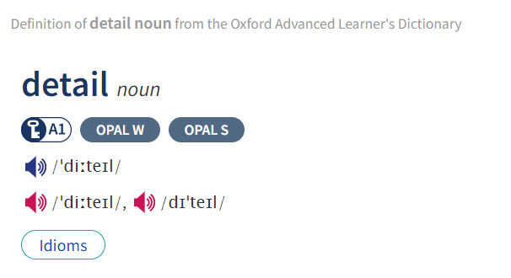

Slide 35
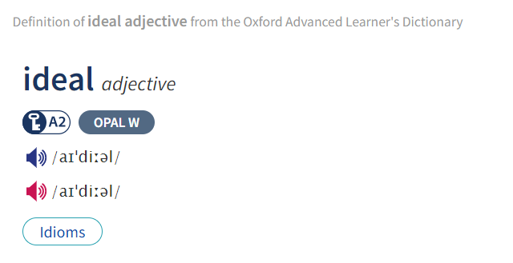

Slide 36
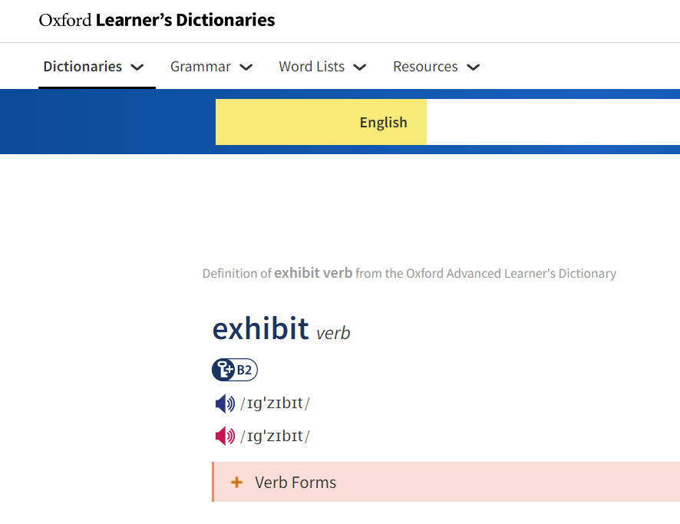

Slide 37
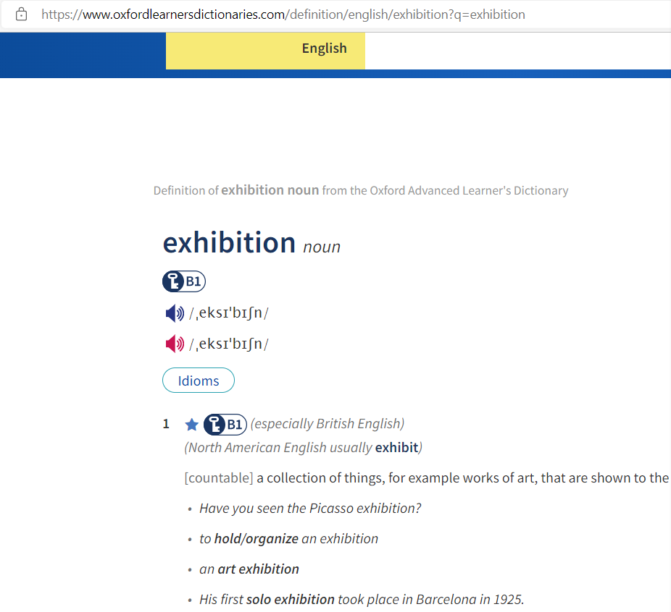
https://www.oxfordlearnersdictionaries.com/

Slide 38
Worldview
It belongs to the core part of culture, for it influences all aspects of our perception and consequently affects our belief and value systems as well as how we think and act. (P.40)
It produces great effects on the social, economic, and political life of a nation.

Slide 39
Holistic vs. Dualistic Worldviews (P.41)
1. Ancient Greek philosophers– the foundation of the Western civilizations:
The pre-Socratic philosophers –Thales, Pythagoras, Heraclitus and Democritus- tried to find what the world was made up of: water, fire, numbers or atoms.
[ˈθeiliːz] 泰勒斯，古希腊时期的思想家、科学家、哲学家 (water)
[paɪ‘θæɡərəs]毕达哥拉斯，古希腊数学家、哲学家 (number)
赫拉克利特(纪元前五世纪的希腊哲学家) (fire)
[di'mɔkritəs] 德谟克利特(约公元前460-370古希腊哲学家)；(atoms)

Slide 40
Holistic vs. dualistic worldviews (P.41)
Plato- He conceived of reality of two parts:
the lower part –material things;
the higher part—ideas
Aristotle—natural world. Two opposing parts—element and form, reality and reason, matter and form
Descartes & Hegel—matter & mind, real object & absolute spirit.
笛卡尔(法国哲学家、数学家；1596-1650)；
黑格尔(德国哲学家;1770-1831)

Slide 41
Holistic vs. dualistic worldviews (P.42)
2. Ancient Chinese proposition—Tao, Yin & Yang, Book of Changes
Tao Te Ching– Tao gave birth to the one, the One gave birth successively to two things, three things, up to ten thousand.
道德经---道生一，一生二，二生三，三生万物
Human beings co-exist with Heaven and the Earth;
All the things are well integrated with Humanity.
天地与我并生；而万物与我为一

Slide 42
Holistic vs. dualistic worldviews (P.42)
1. Ancient Greek —Universe is divided into two opposites and there is a clear-cut demarcation between the two: man and nature, subject and object, mind and matter, the divine and the secular. [diːmɑː'keɪʃ(ə)n]
Christianity explains this God creates Man and Man sins against God. The theme of Bible is redemption of humanity is developed. [ˌkrɪstiˈænəti]
There exists a clear division between God and Man.

Slide 43
Holistic vs. dualistic worldviews (P.43)
2. Ancient Chinese —emphasized the “One”, the “blending” and the “harmony”.
Chuang Tzu—One reality is all men, gods and things: complete, all-embracing and the whole, it is an all-embracing unity from which nothing can be separated. Man is a part of Nature.
Confucianism– the dominant ideology in China seeks to teach the proper way for all people to behave in society, with the purpose of promoting harmony./ˌaɪdiˈɒlədʒi/

Slide 44
Holistic vs. dualistic worldviews (P.43)
《老子》第五十八章：“祸兮福之所倚；福兮祸之所伏。”
战国·宋·庄周《庄子·则阳》：“安危相易，祸福相生，缓急相摩，聚散以成。”
“物极必反”、“乐极生悲”、“否极泰来”、“塞翁失马焉知非福”
中国古代辩证法发端于三千年前的《易经》，德国著名哲学家、辩证法大师黑格尔，也声称自己的“正反合”辩证法来源于中国的《易经》，黑格尔辩证法思想是马克思主义辩证法的直接来源，因此可以说，马克思主义辩证法与中国古代辩证法是一脉相承的。
View sth. Dialectically

Slide 45

Towards Nature
Western Philosophy
Conquer and Transform (separate)
VS
Chinese Philosophy
The harmony of man with nature (integral/ˈɪntɪɡrəl//ɪnˈteɡrəl/)

Slide 46
There are two basic reasons why Americans climb the mountains. The most important reason is to get to the top. This is a matter of meaning the challenge of the mountain. Can I do it? Do I have the physical fitness, strength, and endurance to meet the challenge? Can I conquer nature by conquering the mountain? How fast can I do it? The second reason is to see the view of the top? (P.46)

Slide 47
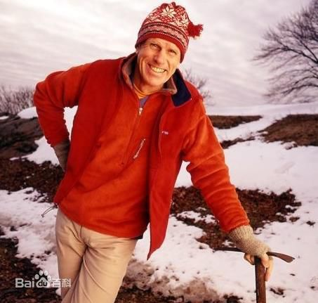
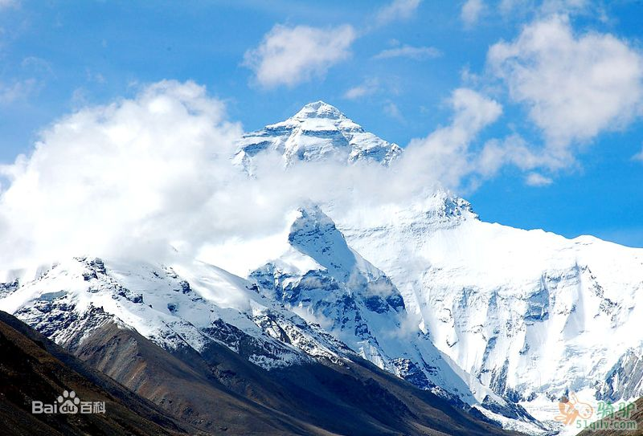
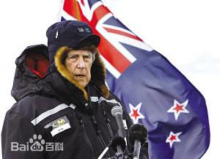
Edmund Percival Hillary (New Zealand)
Qomolangma;Mount Everest

Slide 48
Why similarity and differences?
Take a look at the following figures

Slide 49
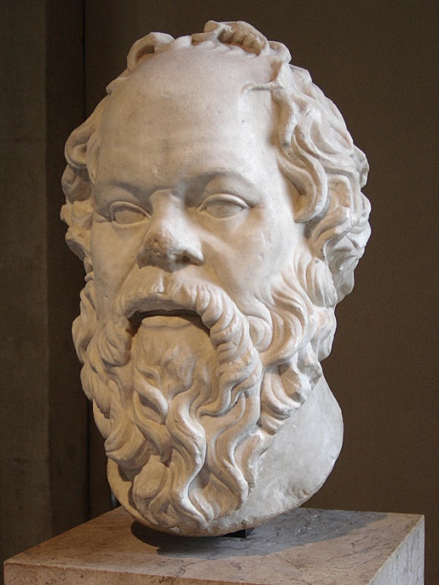
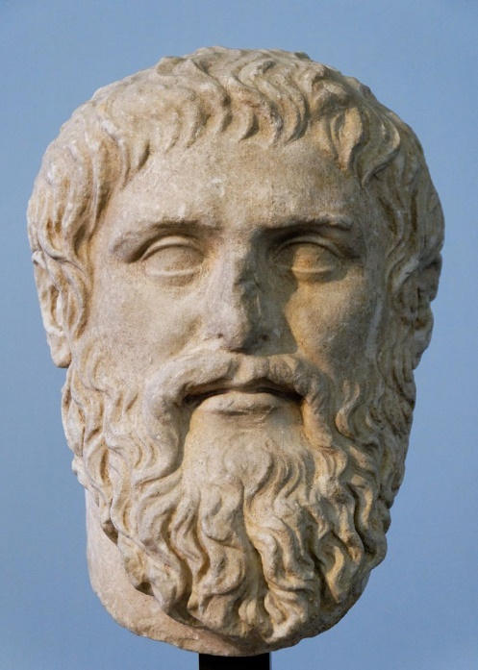
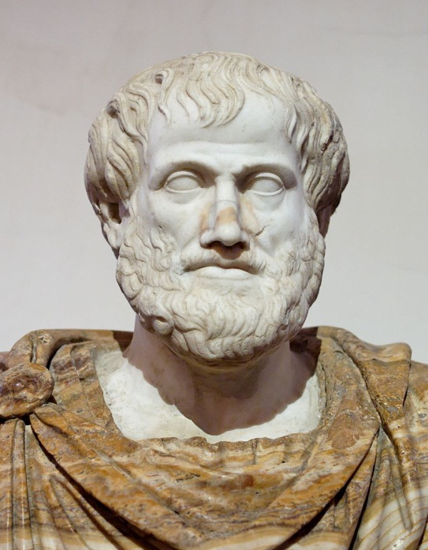
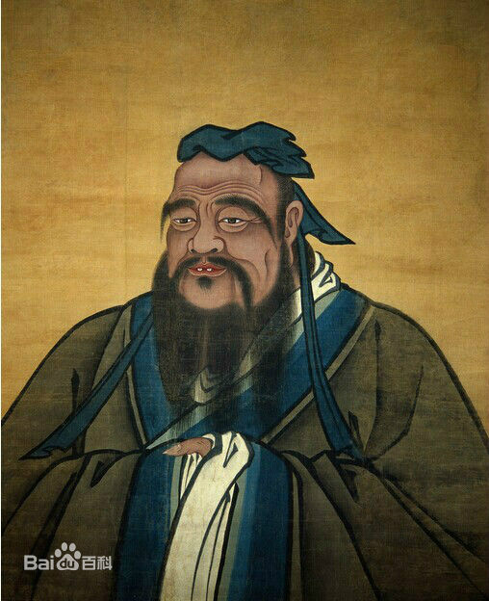
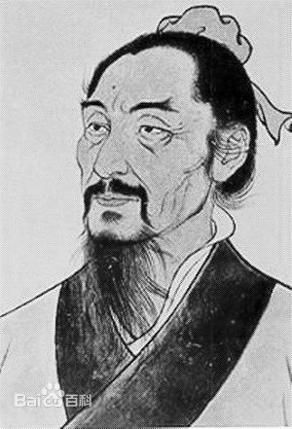
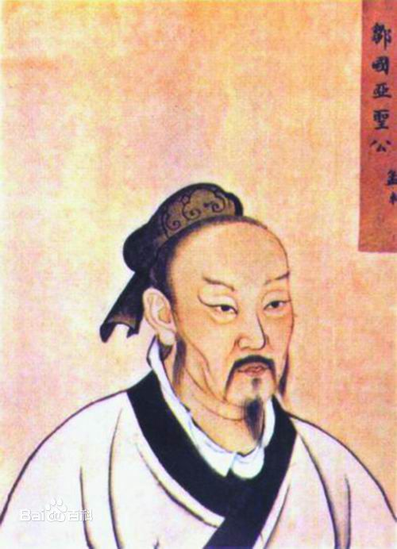

Slide 50
Socrates470 – 399 BC
Plato 427-347BC
Aristotle384–322 BC
Confucius 551 – 479 BC
Mocius 470 – 391 BC
Mencius372 – 289 BC

Slide 51
I am convinced that you are familiar with these figures and even firmly believe you know a lot about them; however, I am not sure how many of you have considered the following question.
Why did the most influential great figures both in the East and the West almost live in same period of the history?
After-class work

Slide 52
Economical base (prerequisite/precondition)
Social reality (social upheaval and political turmoil)
Historical necessity (accumulation of culture/civilization; foundation of previous development)
A certain stage of human development (cognitive development)
Determinism of geographical environment（希腊：北纬35度至北纬42度之间：中国：北纬 3°51′N至53°33′N；印度：北纬8至36度。）...四大文明均集中北纬30度

Slide 53
地理环境决定论：其主要观点认为人类的身心特征、民族特性、社会组织、文化发展等人文现象受自然环境直接或间接的深刻影响。此论的代表人物有希腊的亚里士多德，法国的孟德斯鸠，德国的黑格尔。
Determinism of geographical environment
considers human physical and mental characteristics, national characteristics, social organization, cultural development and other human phenomena to be directly or indirectly affected by the natural environment. The representative figures of this theory are Aristotle in Greece, Montesquieu in France and Hegel in Germany.

Slide 54
The Spring and Autumn Period;
The decline of the city of Athens and the rise of Macedonia [ˌmæsiˈdəunjə] (Alexander the Great)
Unrest, turbulence, wars; all schools of thoughts prevail, Greek sophists[ˈsɒfɪst]
（1）都生活在动荡的年代,战争频繁.孔子生活在春秋战国时期,诸候纷争；后三人生活在雅典城邦衰落的时代,战争不断；（2）都处于思想文化活跃时期.春秋战国时期中国出现百家争鸣；雅典出现了智者学派。
正所谓 时势造英雄

Slide 55
智者学派是公元前 5—前 4 世纪活跃在古希腊以雅典为中心的各城邦的一批职业教师、演说家、作家。“智者”原指古希腊的哲人，后泛指有智慧、有能力、技艺超群者，公元前 5 世纪中期后，具特殊含义，成为以收费授徒为职业的一部分人的专称。这些职业教师在各种公共集会上发表演说，回答各种问题， 教授青年如何辩论和处理公务、家务。第一个收取学费并称己为智者的是普罗泰戈拉。

Slide 56
Common social background:
Social upheaval and political turmoil (P. 44)
To put it simply, it is the overwhelming changes in society and the political unrest that became one of the reasons to foster so many great minds simultaneously.
The same or similar embodiment of cognition

Slide 57
Holistic & Dualistic Worldviews
Western medicine vs. Traditional Chinese Medicine (PP.44-45)
Chinese vs. Western Paintings (P.109)

Slide 58
Holistic & Dualistic Worldviews
What are the philosophical basis of Chinese Holistic Worldview?
Can you define “Dualistic Worldview” in your own words?

Slide 59
Holistic & Dualistic Worldviews
What are the philosophical basis of Chinese Holistic Worldview?
Tao gave birth to the one, the One gave birth successively to two things, three things, up to ten thousand.
Man is part of Nature.
The harmony/blending/integration of Man with Nature; Man is well intergrated with Nature
Heaven and Earth coexist with Human beings; All things are well integrated with Man.
The balance of Ying & Yang
Harmony is advocated/encouraged/precious/invaluable.

Slide 60
Holistic & Dualistic Worldviews
II. Can you define “Dualistic Worldview” in your own words?
Dualistic worldview refers to the ideas or perspectives people hold to divide the whole world into two opposing parts: matter & mind; subject & object; Man & God, etc.

Slide 61
Holistic vs. dualistic worldviews (P.42)
2. Ancient Chinese proposition—Tao, Yin & Yang, Book of Changes
Tao Te Ching– Tao gave birth to the one, the One gave birth successively to two things, three things, up to ten thousand.
道德经---道生一，一生二，二生三，三生万物
Human beings co-exist with Heaven and the Earth;
All the things are well integrated with Humanity.
天地与我并生；而万物与我为一

Slide 62
Holistic vs. Dualistic Worldviews (P.42)
2. Ancient Chinese proposition—Tao, Yin & Yang, Book of Changes
A. Tao Te Ching– Tao gave birth to the one, the One gave birth successively to two things, three things, up to ten thousand.
B. These ten thousand creatures cannot turn their backs to the shade (Yin) without having the sun (Yang) on their bellies, and it is on this blending of the breaths that their harmony depends.

Slide 63
Holistic vs. dualistic worldviews (P.43)
2. Ancient Chinese —emphasized the “One”, the “blending” and the “harmony”.
Chuang Tzu—One reality is all men, gods and things: complete, all-embracing and the whole, it is an all-embracing unity from which nothing can be separated. Man is a part of Nature.
Confucianism– the dominant ideology in China seeks to teach the proper way for all people to behave in society, with the purpose of promoting harmony./ˌaɪdiˈɒlədʒi/

Slide 64
Holistic vs. Dualistic Worldviews (P.41)
Plato- He conceived of reality of two parts:
the lower part –material things;
the higher part—ideas which material things were always patterned.
Aristotle—natural world. Two opposing parts—element and form, reality and reason, matter and form
Descartes & Hegel—matter & mind, real object & absolute spirit.
笛卡尔(法国哲学家、数学家；1596-1650)；
黑格尔(姓氏；德国哲学家)

Slide 65
Holistic vs. Dualistic Worldviews (P.42)
1. Ancient Greek —Universe is divided into two opposites and there is a clear-cut demarcation between the two: man and nature, subject and object, mind and matter, the divine and the secular. [diːmɑː'keɪʃ(ə)n]
Christianity explains this God creates Man and Man sins against God. The theme of Bible is redemption of humanity is developed. [ˌkrɪstiˈænəti]
There exists a clear division between God and Man.

Slide 66
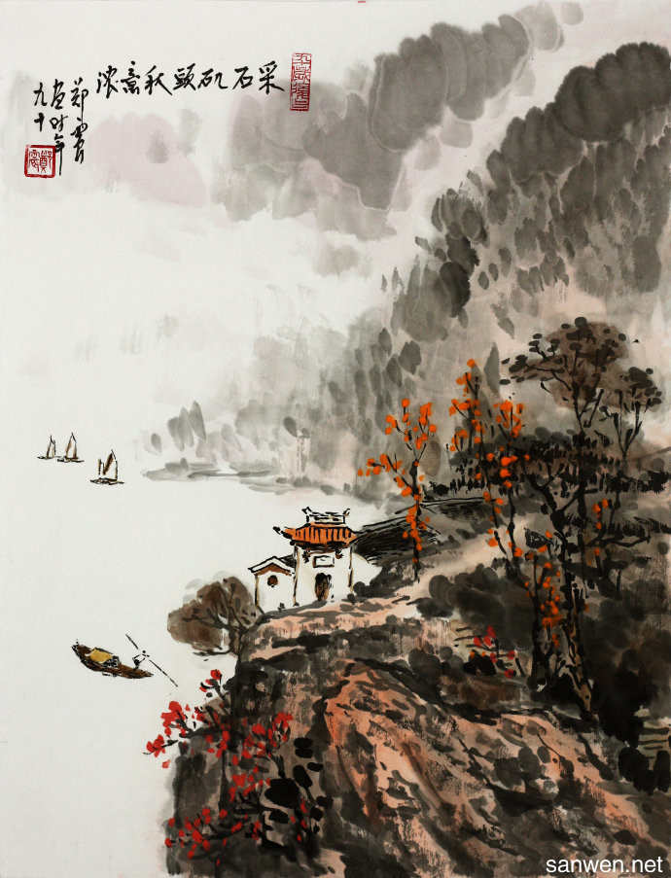
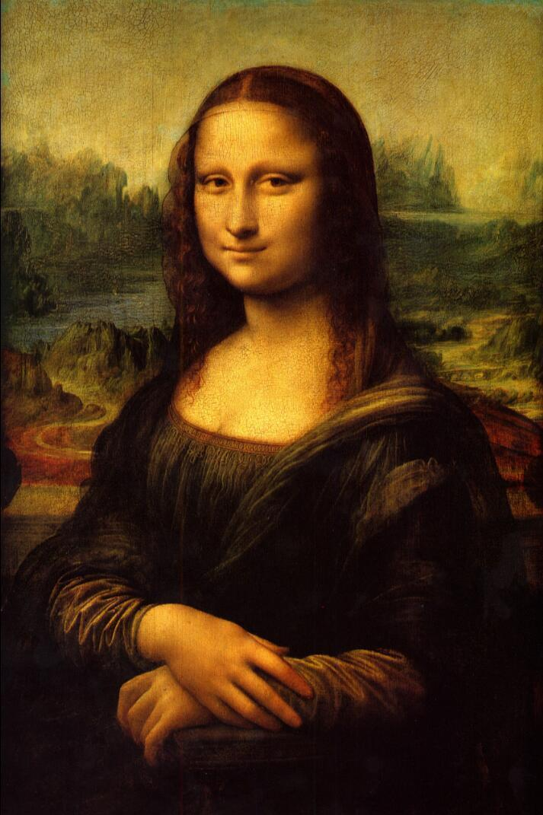

Slide 67
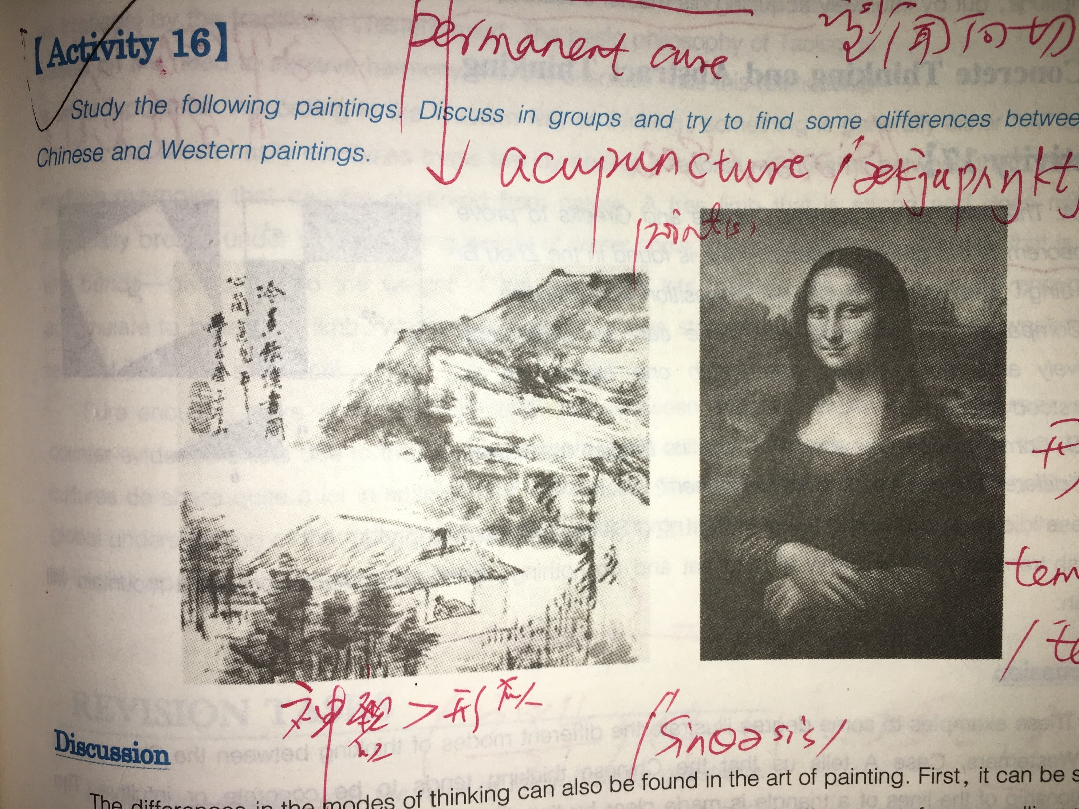

Slide 68
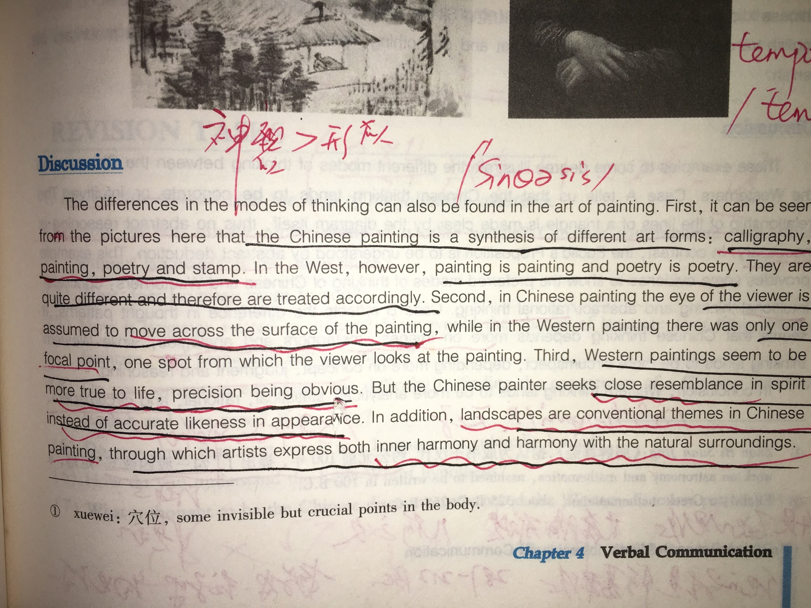

Slide 69
Values:
Definition: one’s principles or standards; one’s judgment of what is valuable or important in life. (P.50)
Values develop standards and guidelines that establish appropriate and inappropriate behavior in a society.

Slide 70
Values:
Types:
universal;
culture-specific;
individual

Slide 71
Values:
Characteristics
Values are learned;
Values are hidden;
Values are interrelated;
Values are changeable.

Slide 72
Worldviews (P.40)
世界观(World Views)是人们对整个世界以及人与世界关系的总的看法和根本观点。
World Views are the general and fundamental views on the whole world and the relationship between mankind and the world.

Slide 73
Holistic & Dualistic Worldviews
Holistic worldview refers to the ideas or perspectives people hold to regard the outside world as a whole unit, believing there is only one origin of the world.
Dualistic worldview refers to the ideas or perspectives people hold to divide the whole world into two opposing parts: matter & mind; subject & object; Man & God, etc.

Slide 74
Holistic vs. dualistic worldviews (P.42)
2. Ancient Chinese proposition—Tao, Yin & Yang, Book of Changes
Tao Te Ching– Tao gave birth to the one, the One gave birth successively to two things, three things, up to ten thousand.
道德经---道生一，一生二，二生三，三生万物
Human beings co-exist with Heaven and the Earth;
All the things are well integrated with Humanity.
天地与我并生；而万物与我为一

Slide 75
Holistic vs. dualistic worldviews (P.42)
1. Ancient Greek —Universe is divided into two opposites and there is a clear-cut demarcation between the two: man and nature, subject and object, mind and matter, the divine and the secular. [diːmɑː'keɪʃ(ə)n]
Christianity explains this God creates Man and Man sins against God. The theme of Bible is redemption of humanity is developed. [ˌkrɪstiˈænəti]
There exists a clear division between God and Man.

Slide 76
IV. Instruments comparing cultural values
Kluchhohn’s value orientations
克拉克洪与斯乔贝克的价值取向理论（1961）
Hofstede’s value dimensions
霍夫斯泰德的价值维度理论（1980，1991）

Slide 77
克拉克洪与斯乔贝克的理论
Human nature orientation
Man-nature orientation
Time orientation
Activity orientation
Social orientation

Slide 78
克拉克洪与斯乔贝克的理论
What is the character of innate human nature?
What is the relation of man with Nature?
What is the temporal focus (time sense) of human life?
What is the mode of human activity?
What is the mode of human relationships?

Slide 79
Categories for comparing values across cultures
Orientation | Basic values
Human Nature | Basically evil | Mixture of good and evil | Basically good
Relationship to Nature | Nature controls humans | Harmony with nature | Humans control nature
Sense of Time | Past | Present | Future
Activity | Being – who you are | Growing - becoming | Doing – what you are doing
Social Relationship | Hierarchy | Group | Individual

Slide 80

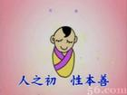
Human nature P.55
Basically evil but perfectible
Basically good but corruptible
Mixture of good and evil

Slide 81
Human nature
Original sin, is a Christian belief in the state of sin in which humanity has existed since the fall of man, stemming from Adam and Eve's rebellion in Eden, namely the sin of disobedience in consuming the forbidden fruit from the tree of the knowledge of good and evil./ˈkrɪstʃən/
Basically evil but perfectible

Slide 82
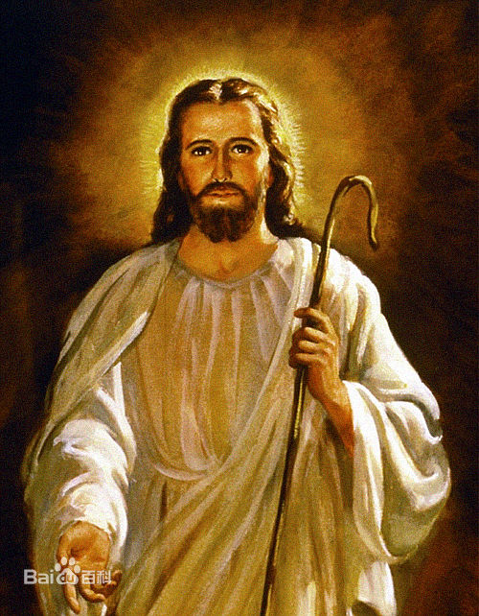
Human nature
Basically evil but perfectible

Slide 83
The Tower of Babel
The Tower of Babel as told in Genesis 11:1–9 is an origin myth meant to explain why the world's peoples speak different languages.
According to the story, a united humanity in the generations following the Great Flood, speaking a single language and migrating eastward, comes to the land of Shinar. There they agree to build a city and a tower tall enough to reach heaven. God, observing their city and tower, confounds their speech so that they can no longer understand each other, and scatters them around the world.

Slide 84
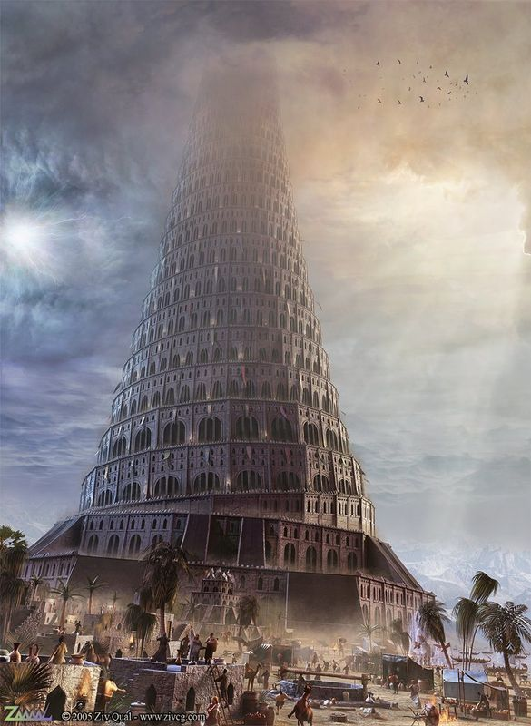
巴别塔;是《圣经·旧约·创世记》第11章记载，当时人类联合起来兴建希望能通往天堂的高塔;为了阻止人类的计划，上帝让人类说不同的语言，使人类相互之间不能沟通，计划因此失败，人类自此各散东西。此事件，为世上出现不同语言和种族提供解释。

Slide 85
古巴比伦王国（约公元前3500年左右－公元前729年）位于美索不达米亚平原，大致在当今的伊拉克共和国版图内。距今约5000年左右，这里的人们建立了国家，到公元前18世纪，这里出现了古巴比伦王国。“美索不达米亚”——《圣经》称为“伊甸园”，是古希腊语，意为“两条河中间的地方”，故又称为两河流域。“两河”指的是幼发拉底河和底格里斯河。在这平原上发展了当时世界上少有的几个城市，流传最早的史诗、神话、药典、农人历书等，是西方文明的摇篮之一。有空中花园，但都成废墟。

Slide 86
Explanations of Superstitions in Western Culture
The origins of Friday superstitions: Biblical Stories
Eve tempted Adam with the apple on a Friday, leading to the punishment from the God: being thrown out the Eden and their descendants born with Original Sin. (Human nature is evil in the west)
Great Flood in the Bible happened on Friday;
The confusion of the Tower of Babel took place on Friday;
Jesus was crucified on Good Friday.
...

Slide 87
Explanations of Superstitions in Western Culture
The origins of 13th superstitions:
There were 13 people at the last supper of Jesus, who was betrayed by Judas Priest which caused his death on Good Friday.
In Norwegian myth, 12 gods were invited for a happy dinner, but the uninvited 13th visitor brought death and darkness. /nɔːˈwiːdʒən/
In Roman tale, 12 witches got together and the 13th visitor was a devil. /ˈrəʊmən/
...

Slide 88
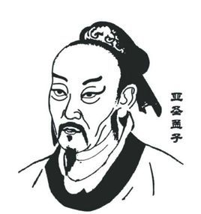
Human nature
The theory of good nature is an exposition of human nature put forward by Mencius during the Warring States Period. Mencius believed that human nature was originally good, and that being good was the expression of his nature, while not being good was contrary to his nature.
Basically good

Slide 89
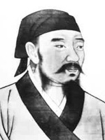
Human nature
Basically evil
性恶论，是指荀子所论及的人性，其本质恰是无所谓善恶的"本始材朴"的自然之性，它既有转化为恶的可能，也有发展为善的机会。荀子的性恶论的思想在先秦百家关于人性的论断中独树一帜，他的思想对后世今天的意义都是值得我们去思考的。

Slide 90
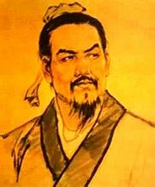
Human nature
Basically evil
对于民众，他吸收了其老师荀子的“性本贪”理论，认为民众的本性是“恶劳而好逸”，要以法来约束民众，施刑于民，才可“禁奸于未萌”。因此他认为施刑法恰恰是爱民的表现。（《韩非子·心度》）。容易让人忽视的是韩非是主张减轻人民的徭役和赋税的。他认为严重的徭役和赋税只会让臣下强大起来，不利于君王统治。

Slide 91
Human nature
Basically evil
韩非(约公元前280--前233年)，战国末期著名思想家、法家代表人物。尊称韩非子或韩子。韩王(战国末期韩国君主)之子，荀子的学生。
作为秦国的法家代表，备受秦王嬴政赏识，但遭到李斯等人的嫉妒，最终被下狱毒死。他被誉为得老子思想精髓最多的二人之一(另一人为庄周)。

Slide 92
Social attitudes as expressions of basic values
Human Nature | Basically evil | Mixture of good and evil | Basically good
 | Expect to find evil and fight against it | Separate good from evil | Protect people’s virtue
 | Punish bad behavior | Identify strengths and weaknesses | Reward good behavior
 | Save people from their evil nature | Reward the good in people and punish the bad | Find the most virtuous people

Slide 93
Relationship to nature
Humans’ subjugation of nature

Slide 94
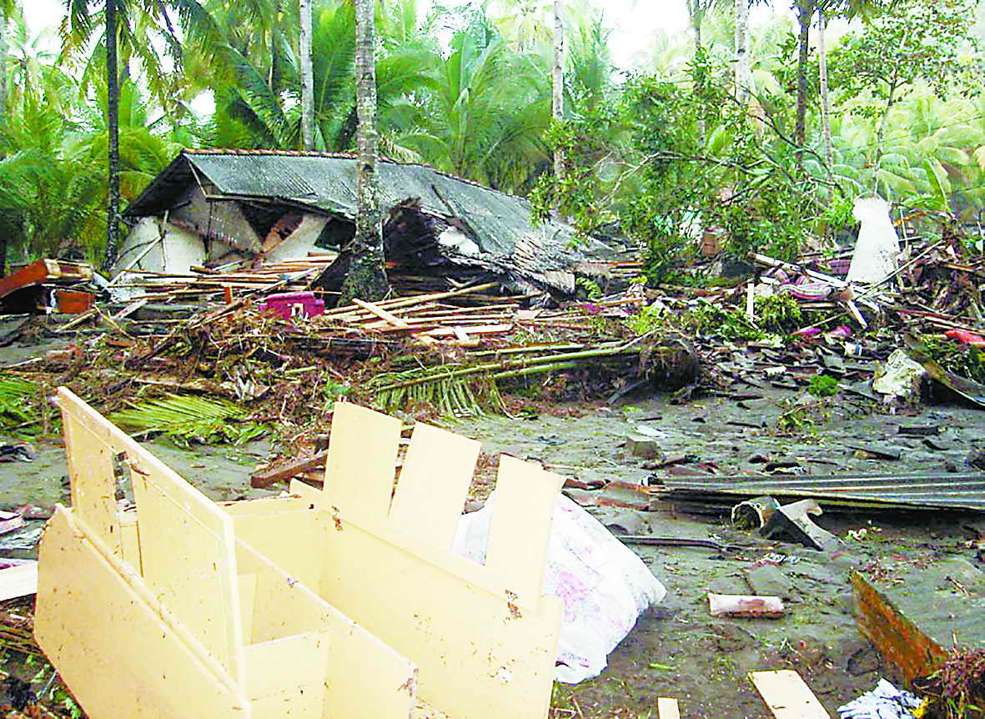
Nature controls humans

Slide 95
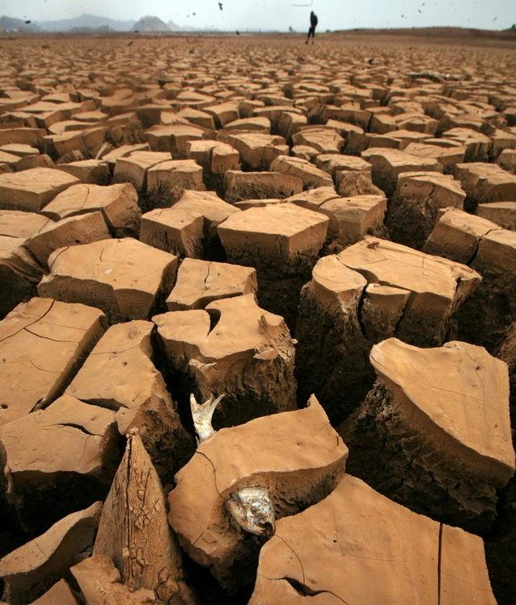

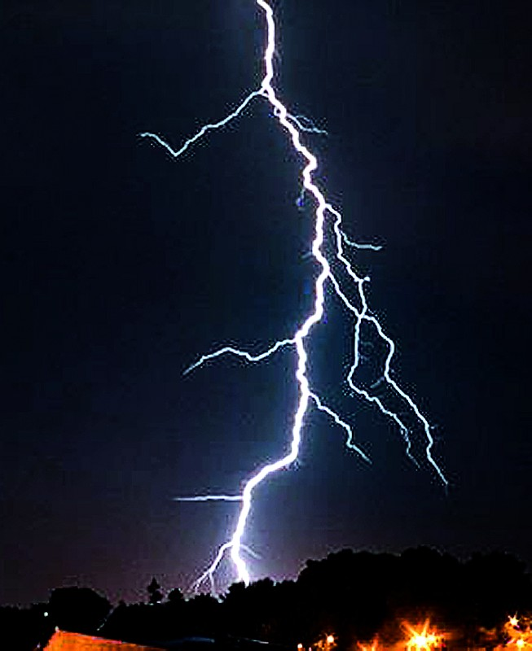

lightning
Drought

Slide 96
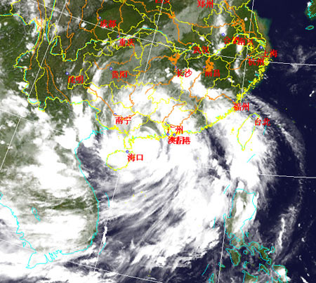

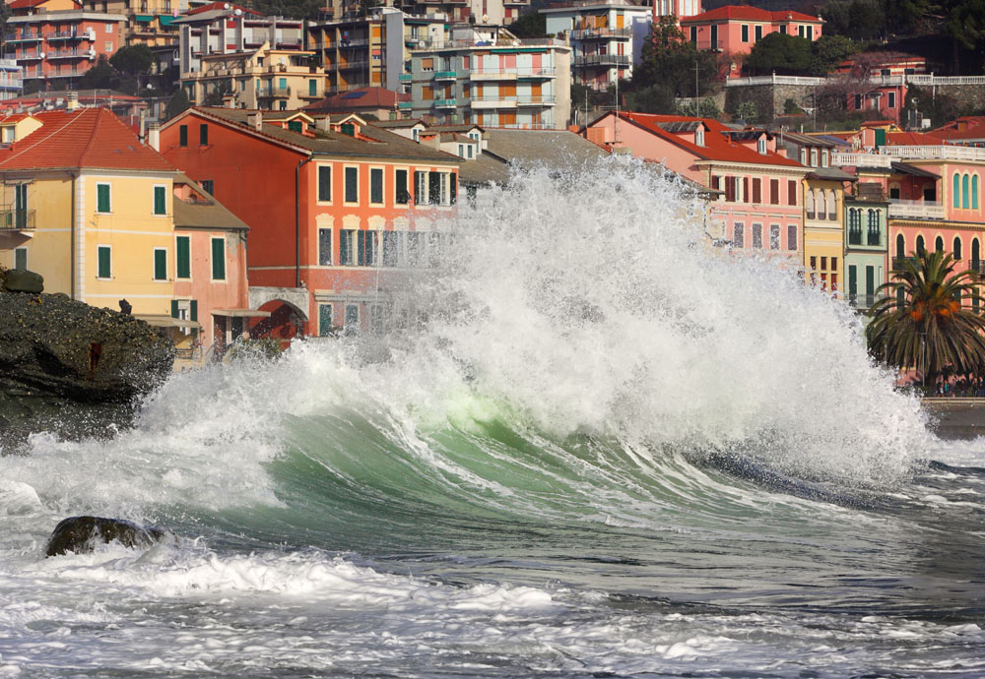

TYPHOON
FLOOD

Slide 97
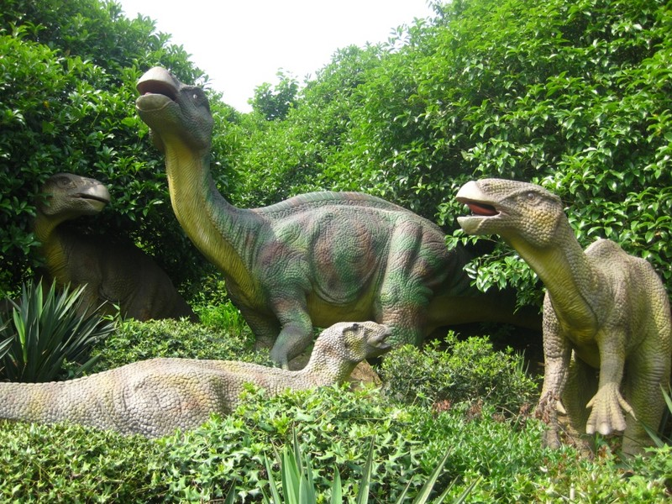
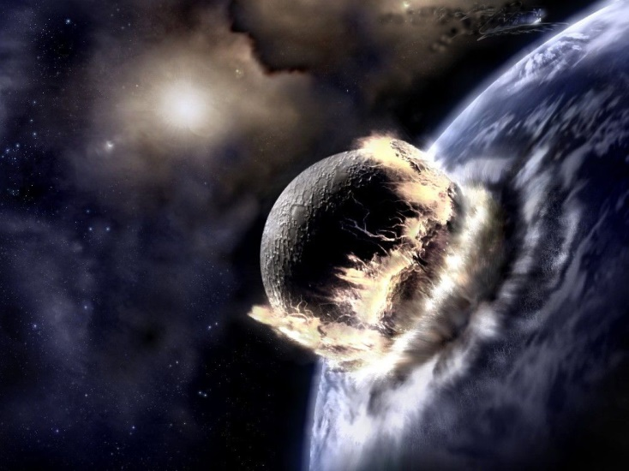
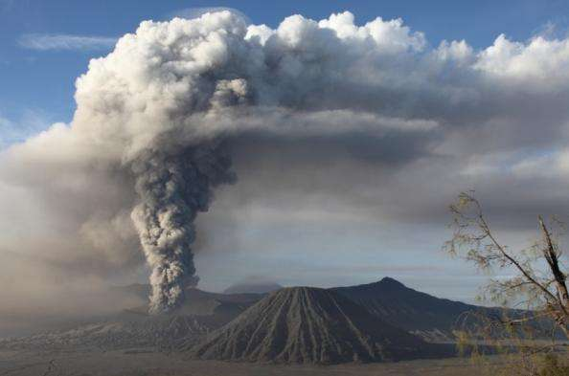
Long long ago, the dinosaur is the King of the earth.
However…
A planet hit the earth; volcano exploded

Slide 98
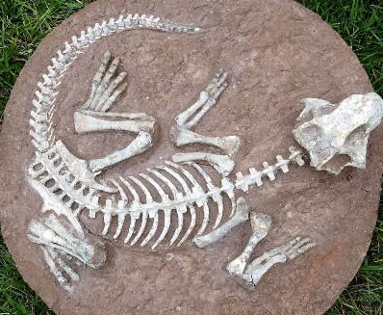
But now we just can see the fossil
Power of Nature
If we do not protect and love our nature, maybe one day that’s our fate.

Slide 99
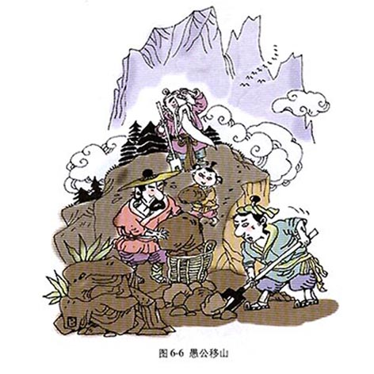
Humans controls nature

Slide 100
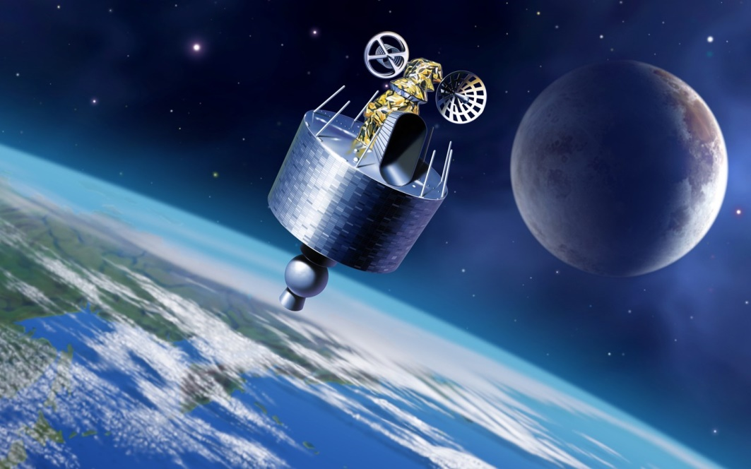

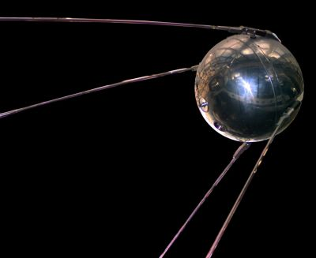

NOW
Human can enter the space…

Slide 101
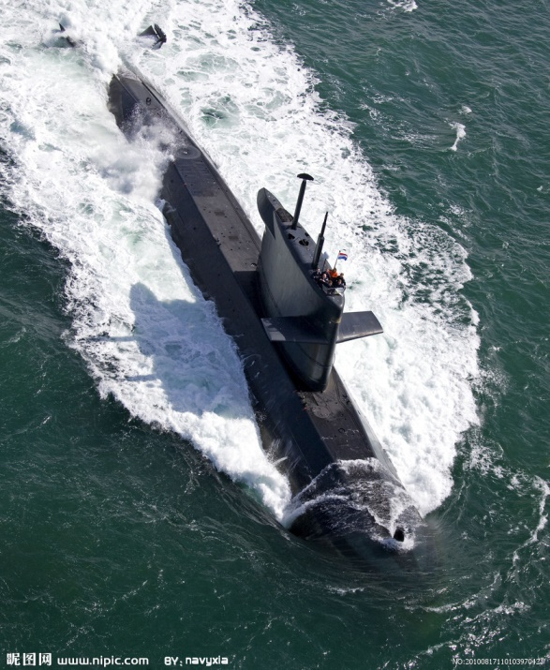
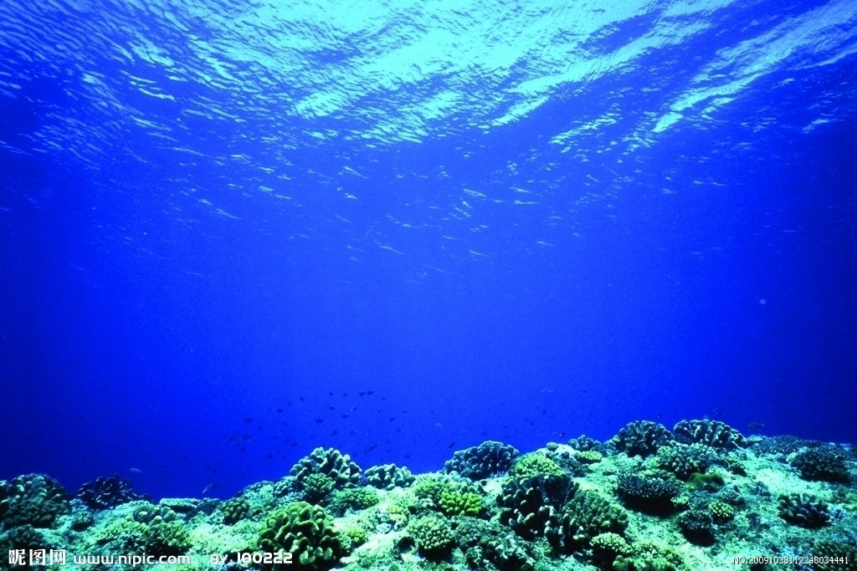
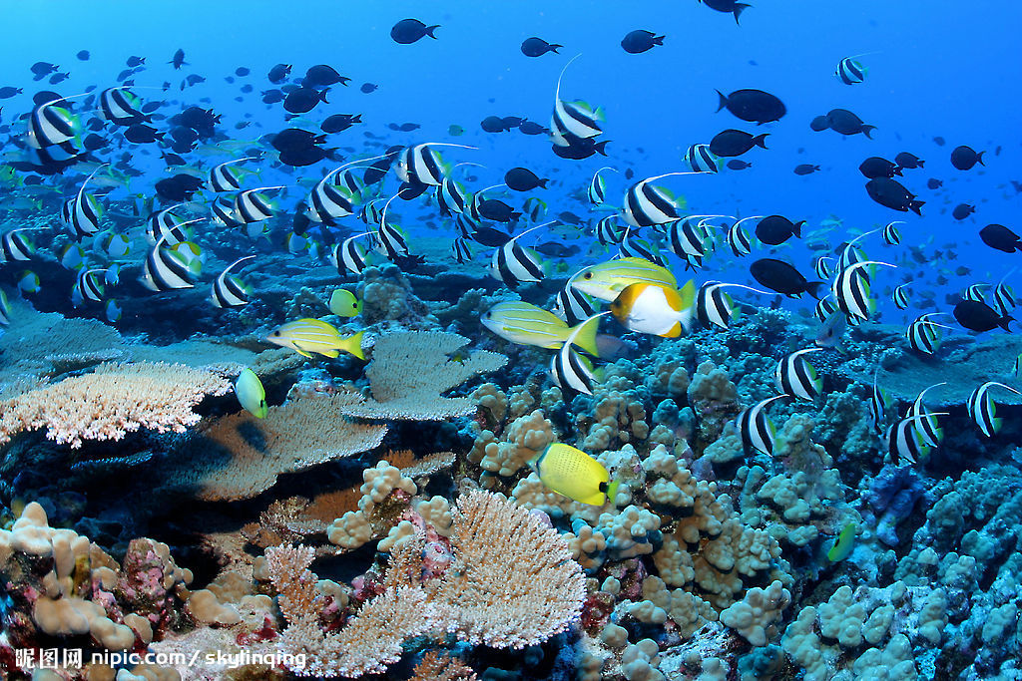
Go into the deep sea…
submarine

Slide 102
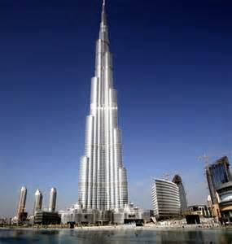
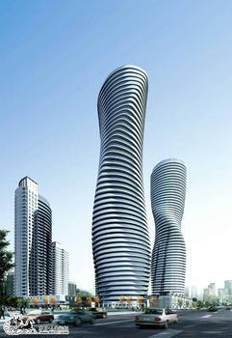

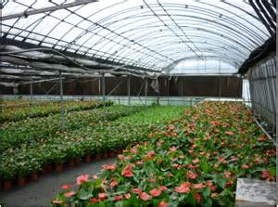
We transformed nature for a comfortable city life, a basic need to survive or even a means to entertain ourselves.

Slide 103
Relation-ship to Nature | Nature over humans | Harmony with nature | Humans over nature
 | Accept your fate | Live according to the rhythms of nature | Make life comfortable and convenient
 | Life is outside the individual’s control | Everything has its own character | Problems can be solved once we know the facts
 | Be humble | Be balanced | Be objective

Slide 104
Holistic & Dualistic Worldviews
II. Can you define “Dualistic Worldview” in your own words?
Dualistic worldview refers to the ideas or perspectives people hold to divide the whole world into two opposing parts: matter & mind; subject & object; Man & God, etc.

Slide 105
Categories for comparing values across cultures
Orientation | Basic values
Human Nature | Basically evil | Mixture of good and evil | Basically good
Relationship to Nature | Nature controls humans | Harmony with nature | Humans control nature
Sense of Time | Past | Present | Future
Activity | Being – who you are | Growing - becoming | Doing – what you are doing
Social Relationship | Hierarchy | Group | Individual

Slide 106
Sense of time
Past-oriented
Present-oriented
Future-oriented

Slide 107
Sense of time | Past | Present | Future
 | Tradition is the best teacher | Pay attention to what is going on here and now | Control the future by planning for it
 | What happened in the past is important today | Everything will happen in its time | What is past is past and not important
 | The old are wise | Future is vague, ambiguous | The young know what is happening

Slide 108
Activity
Being-oriented is a non-developmental model of society with the stress on who you are.
Being-in-becoming-oriented stresses on a spiritual life than a material one.
Doing-oriented stresses on action.
e.g. Being-in-becoming is a kind of spiritual good of inner harmony and peace

Slide 109
Activity
Being-oriented is a non-developmental model of society with the stress on who you are. (current state)
The family background is more important than what they accomplish.
People behave in ways appropriate to their position (status, social roles, and characters) in life.
Be satisfied with current situations and obey the hierachical realtionship （满足现状；认可等级差异和权力距离）

Slide 110
Activity
Being-in-becoming-oriented stresses on a spiritual life than a material one.
For instance, in both Hinduism and Buddhism, people spend a great portion of their lives in meditation and contemplation in an attempt to purify and more fully advance themselves.
For them, this inner or spiritual development represents one of the main purposes of life.

Slide 111
Activity
Doing-oriented stresses on action/external accomplishments.
The goal is to achieve as much as possible. You want to do things and to achieve success. So you tend to be more active. Because the emphasis is on action in doing culture, the goals toward which action is directed are also emphasized. And there is often a sense of urgency about getting things done. Deadlines are important, as is the schedule. To have a full schedule indicates that you are accomplishing things.
Hegemonism [hiː'gemənɪzəm] hegemony [hɪˈɡemənɪ]

Slide 112
Social relationship
Hierarchy: This means each person has a position in a hierarchy. People have clearly defined privileges and obligations according to their position in relation to others.
Group: In cultures with group values, people make decisions by consensus. Loyalty is overemphasized.
Individual: self-reliance and independence.

Slide 113
Activity | Being | Growing | Doing
 | Protect your dignity and the dignity of others | Develop your potential as a whole person | Achieve specific goals
 | Fulfill your role | Purify and advance oneself | Develop procedures and measure results
 | Show the world who you are | People change and won’t be the same tomorrow as they are today | Show the world what you can do
 | Pay attention to people | Pay attention to possibilities | Pay attention to actions

Slide 114
Social relation-ships | Hierarchy | Group | Individual
 | Obey authority; know your place | Respond to what others think and feel | Express your own feelings and ideas
 | Treat others according to their position | Depend on others and let them depend on you; be loyal | Be as independent and self-reliant as possible
 | Look to leading figures to know what to think and do | Look to others in your group to know what to think and do | Make your own decisions and choices

Slide 115
IV. Instruments comparing cultural values
Kluchhohn’s value orientations
克拉克洪与斯乔贝克的价值取向理论（1961）
Hofstede’s value dimensions
霍夫斯泰德的价值维度理论（1980，1991）

Slide 116
克拉克洪与斯乔贝克的理论
Human nature orientation
Man-nature orientation
Time orientation
Activity orientation
Relational orientation

Slide 117
Review
Based on Kluchhohn’s Value Orientations, Which value orientation does American culture belong to?
1. human nature: good or evil ?
2. man & nature relation: M>N, N>M, or Harmony of M & N ?
3. sense of time: future, past or the present?
4. sense of activity: being, being-in-becoming, or doing?
5. social relationship: hierarchy, group or individual?

Slide 118
Hofstede’s value dimensions 霍夫斯泰德的价值维度理论
Individualism-Collectivism
Power Distance
Masculinity-Femininity
Uncertainty Avoidance
个人---集体主义
权力距离
男性特质---女性特质
不确定性规避

Slide 119


Collectivism
Individualism

Slide 120
Case Study (1)
An Iranian student who had earned a doctorate in the United States returned home to teach in an Iranian university. He was offered position at three universities, and had to decide which one to accept. An American friend who was visiting him in Iran noticed that the man’s older brother had accompanied him to all the interviews at the universities, and she asked him about it. The man, who was nearly 40, explained that he would follow the advice of his brother in choosing the position. “But why?” asked the American in amazement. “Oh,” replied the Iranian, “because he is the head of the family now, and I must do whatever he thinks will be best for the family.”

Slide 121
Individualism VS Collectivism

Slide 122
Characteristics of Individualism
An “I” consciousness prevails;
Competition rather than cooperation is encouraged;
Personal goals take precedence than group goals;
Be not emotionally dependent on organization or institutions;
Every individual has the right to his/her private property, thoughts, and opinions.

Slide 123
Characteristics of Collectivism
A “we” consciousness prevails: identity is based on the social system;
the individual is emotionally dependent on organizations and institutions;
belonging to organizations is emphasized;
and group goals rather than personal ones take the precedence.

Slide 124

Family Structures (Extended Family)
（原标题：90后演员徐婷生前求助中医治癌
放血拔罐照曝光）
born in 1990
7 kids
lymph cancer
feel released after suffering the disease
never live for herself (26years)
live in basement with 300 yuan
dozens of TV plays
quit treatment
live with dignity and optimism

Slide 125
我是陈光标，9月5日，我写了一封给比尔·盖茨和巴菲特的信，宣布在我离开这个世界的时候,将向慈善机构捐出自己的全部财产，引起广大网民朋友和社会各界的广泛关注。很多人对我的行为非常支持，钦佩和感动。你们的支持、赞誉和鼓励，也深深感动着我。然而，也有网友关心：我这么做，家里人理解和支持吗?当人们得知我的妹妹依然在一家饭店洗碗，每月工资只有1800元;我的弟弟依然在做保安，每月工资只有2500元，也有人产生疑问：陈光标为什么这么做，一个人如果对自己亲人不好，怎么可能对其他人好呢?
the most well-known charitarian;philanthropist

Slide 126
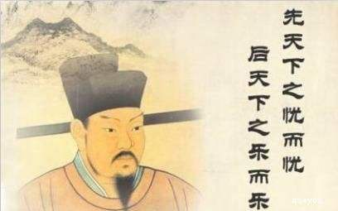
Chinese Idioms and Phrases
先天下之忧而忧，
后天下之乐而乐
天下兴亡，匹夫有责
精忠报国，死而无憾

Slide 127

American Idioms and Phrases
God helps those who help themselves
All man are created equal
Self-centered

Slide 128
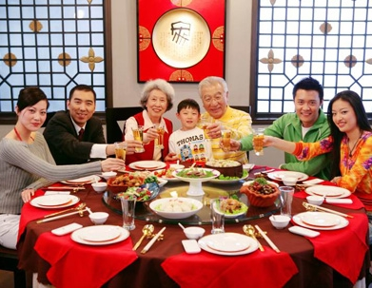
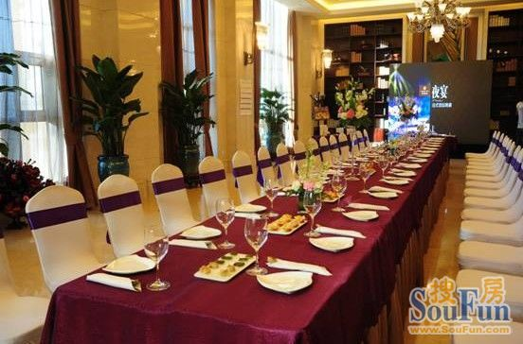
Chinese eating customs
Western eating customs

Slide 129
Case Study (2)
During the American Civil War, a very hungry young man fell down in front of a farm gate. The farmer gave him food but in return he asked the young man to move a pile of wood in his yard---in fact it was not at all necessary to move the wood. When the young man left, the farmer moved the wood back to its original place. Seeing all this, the farmer's son was confused.
Questions:
1.Why did the farmer do that?
2.What values are reflected in this story?

Slide 130
Power distance
It describes the distribution of influence within the culture, the extent to which the less powerful members of organizations and institutions consider that power is distributed unequally.
(P.59 teacher-student-parents)
Large / small power distance
Chinese society-American society
(addressing; group photo with leaders)

Slide 131
Power distance
People in societies with a high power distance are more likely to conform to a hierarchy where "everybody has a place and which needs no further justification".
In societies with a low power distance, individuals tend to try to distribute power equally. In such societies, inequalities of power among people would require additional justification.

Slide 132
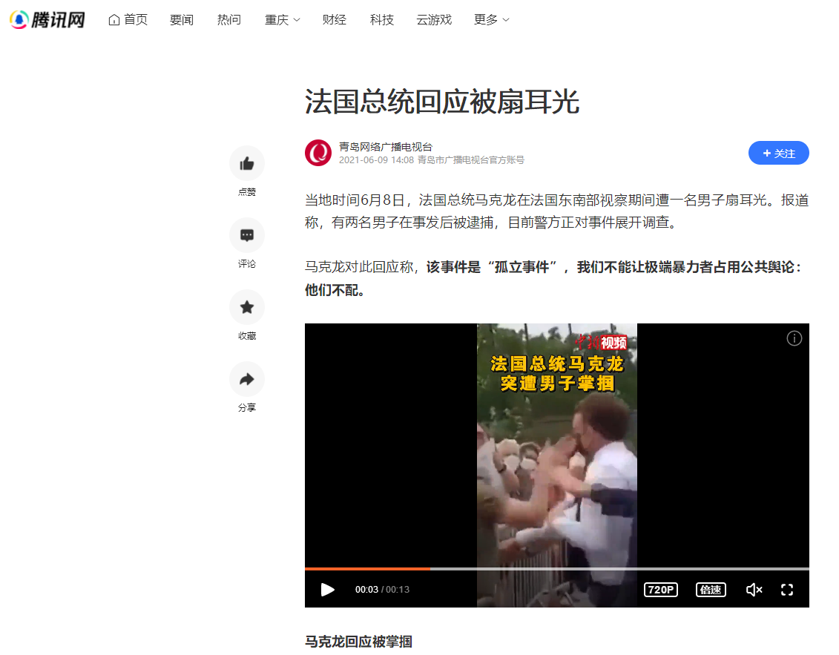
Examples in political affairs
French President Emmanuel Macron gets slapped in the face during a visit for a small town in the southeast France.

Slide 133
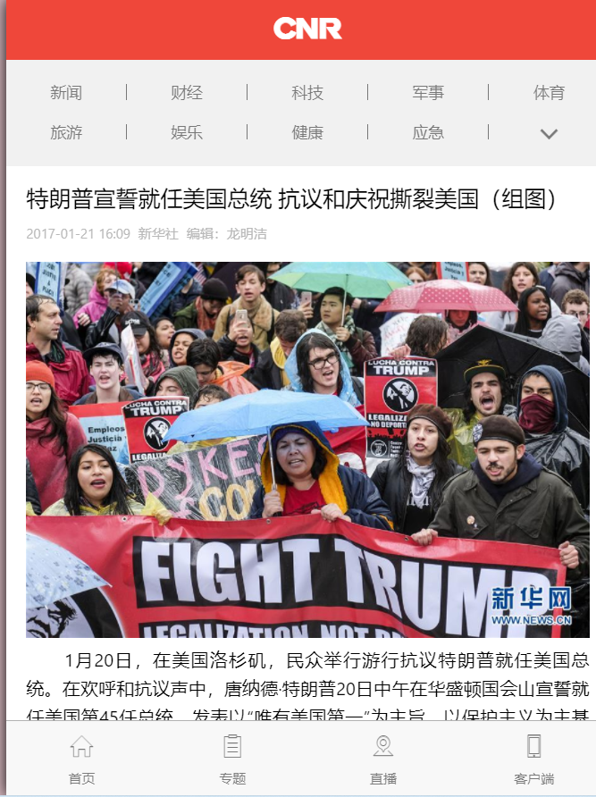
Examples in political affairs
Donald Trump takes the oath of office, protests and celebrations tear America apart

Slide 134
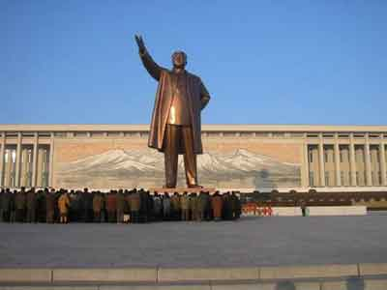
The worship to
the leader
of the North Korea

Slide 135



Examples in political affairs
The former American president is on a vacation/having a meeting .

Slide 136

Examples in school
Classes in low-power distance countries

Slide 137



Slide 138

Classes in high-power distance countries

Slide 139


Examples in business

Slide 140
Power distance
High/ low power distance
Chinese society-American society
(addressing; group photo with leaders)
In China, almost nobody call his parents with the first name while in America, it can be so natural.
Is the leader enjoys the same social status in China and America according to the video?

Slide 141
Power distance
Read the following ancient Chinese sayings and try to understand ancient China belonged to a nation with high or low power distance and tell the reasons.

Slide 142
three principles and five virtues
三纲:君为臣纲，父为子纲，夫为妻纲。五常:仁、义、礼、智、信。
Be obedient to the emperor, the father, the husband
Benevolence, righteousness, manner, wisdom, credit
君让臣死，臣不得不死

Slide 143
Power distance
Read this case and discuss with your partners about whether the high or low power distance is reflected here.
If a teacher reports to parents that their child has misbehaved, the parents will try to find out if the teacher used his authority over the student in the proper way.

Slide 144
Advantages
In low-power distance countries
★Everyone can bring his potencial into play.
★The relationship will become much more harmonious.
In high-power distance countries
★The efficiency will become much higher.

Slide 145
Disadvantages
In low-power distance countries
★The effiency may be influenced by the freedom.
In high-power distance countries
★The staff’s attitudes may be quite unzealous .
★It may cause power abuse.
[ʌnˈzeləs]不积极的；不热情的

Slide 146


Masculinity vs femininity

Slide 147
Masculinity vs femininity
Masculinity is the extent to which the dominant values in a society are male dominated, in which gender roles are clearly distinct and is associated with such behaviors as ambition, differentiated sex/gender roles, achievement, competition, etc..
male chauvinism [ˌmeɪl ˈʃəʊvɪnɪzəm]
sexism [ˈseksɪzəm]
Femininity standing for a society in which gender roles overlap (also called girlishness, womanliness or womanhood) is a set of attributes, behaviors (caring and nurturing) , and roles generally associated with girls and women.

Slide 148
Masculinity vs femininity
Masculinity is the extent to which the dominant values in a society are male dominated.
True or False?
Femininity is the extent to which the dominant values in a society are female dominated.

Slide 149
Masculinity vs Femininity
Read the following ancient Chinese sayings and try to analyze ancient China belonged to a nation of masculinity or femininity.

Slide 150
Three Obediences and Four Virtues
A women's subordination to father, husband, and son
妇德就是守节操，“从一而终”，“一女不嫁二夫”。妇言是要求妇女语言美，讲话讲究分寸、得体，不讲粗话。妇容是女性的容貌美，“女为悦己者容”，要以端庄娴雅的容貌取悦于丈夫。妇功是指劳动，如纺纱、织布、缝纫、刺绣等。
morality; proper speech; modest manner; diligent work

Slide 151
《论语 阳货篇》“唯小人与女子难养也”以及《公祭祁夫人文》中“女子无才便是德”的描述，我们对古人眼中女子的地位便可窥见一斑。

Slide 152
我们想要理解这句话的真实含义，就要设身处地站在孔子的时代下去思考，当时孔子周游列国，原本是想去卫国寻求发展的机会，不料卫国君主亲小人远贤士，对孔子百般愚弄，孔子一时激愤，就指责卫国国君：“吾未见好德如好色者也”。
孔子离开卫国后，说出了“唯女子与小人为难养也”这句话，而这里的“女”是一个通假字，代表汝，就是“你”的意思。所以我们可以得知，孔子的这句话真实含义就是“你就像个小人一样”。
还有一种说法认为这里的女子和小人，指的是君主所宠幸的人。比如卫国国君宠幸身边的妃子，也宠幸身边的奸佞之人，于是孔子才发出了这样的感慨。

Slide 153
孔子说：“女人与小人，他们都很难培养自己的浩然正气，难养身、心、性、命，所以与之相处要有远近分寸，太近了容易失礼，坏了规矩；过于远离，又容易招致怨恨，而不利于儒学的传承。

Slide 154



Slide 155
唯小人与女子难养也，近之则不逊，远之则怨。
女子无才便是德
Only the woman and the villains/peanuts are difficult to cultivate and manage/get along with; near it is offensive, far it is resentful.
A woman without talent is a virtue; Innocence is the virtue for women.

Slide 156
Masculinity vs femininity
But nowadays in China women enjoy a much higher social status than before, especially in some areas like Chongqing Municipality and Sichuan Province.
So it’s hard to say it is a society of masculinity or femininity simply.

Slide 157
Masculinity vs femininity
As you know, in these areas the husband in a family is more likely to cook meals than that in North China. And about 30% of the entrepreneurs are female with 10% higher than that of the whole nation. [ˌɒntrəprəˈnɜː(r)]
小天鹅 奇火锅 沁园 龙湖地产 乡村基 当当网…… 耙耳朵
重庆市女企业家商会曾经提供的一份数据显示，重庆民营企业中，企业法人为女性的超过1/3，女个体户也占到全市总数的1/3。三个重庆老板里就有一个是女人。而全国女个体户占比在20%左右，女性创业致富，重庆走在了全国前列。
女人不只是撑起了半边天，而是撑起了大半边天。

Slide 158
Masculinity vs femininity
Masculinity Index (MAS). The list of countries in order of MAS (high gender roles distinction at work) shows Japan at the top. German-speaking countries (Austria, Switzerland, and Germany) scored high; so did the Caribbean Latin American countries Venezuela(委内瑞拉), Mexico, and Colombia, and Italy.
[ˈswitsələnd] [ˌvenəˈzwilə]

Slide 159
The Anglo countries (Ireland, Great Britain, South Africa, the United States, Australia, New Zealand, and Canada) all scored above average. Asian countries, other than Japan, were in the middle. The feminine side (low gender roles distinction at work) includes other Latin countries (France, Spain, etc.). At the extreme “feminine” pole were the Nordic countries including Sweden, Norway, and the Netherlands (Holland).
Denmark, Iceland, Finland

Slide 160
Netherlands:
In the 17th century, the Netherlands was the world's most powerful maritime hegemon ['hedʒəmɒn] and was known as the Sea Cabby. The Netherlands is a highly developed capitalist country. The Netherlands is the first country in the world to legalize homosexual marriage and euthanasia.[ˌjuːθəˈneɪziə]
欧洲西北部
在17世纪，荷兰是当时世界上最强大的海上霸主，曾被誉为海上马车夫。荷兰是个高度发达的资本主义国家，荷兰是全球第一个同性婚姻与安乐死合法化的国家。

Slide 161
"Going Dutch" is a term that indicates that each person participating in a group activity pays for themself, rather than any person paying for anyone else, particularly in a restaurant bill.
It is also called Dutch date, Dutch treat and doing Dutch.

Slide 162


Slide 163


Slide 164
go dutch
16~17世纪时的荷兰和威尼斯，是海上商品贸易的发迹之地。终日奔波的意大利、荷兰商人们已衍生出聚时交流信息、散时各付资费的习俗来。因为商人的流动性很强，一个人请别人的客，被请的人说不定这辈子再也碰不到了，为了大家不吃亏，彼此分摊便是最好的选择了。而荷兰人因其精明、凡事都要分清楚，逐渐形成了let's go dutch（我们各付各的吧）的俗语。

Slide 165
None of this had even a hope of any practical application in my life. But ten years later, when we were designing the first Macintosh computer, it all came back to me. And we designed it all into the Mac. It was the first computer with beautiful typography. If I had never dropped in on that single course in college, the Mac would have never had multiple typefaces or proportionally spaced fonts. And since Windows just copied the Mac, its likely that no personal computer would have them. If I had never dropped out, I would have never dropped in on this calligraphy class, and personal computers might not have the wonderful typography that they do. Of course it was impossible to connect the dots looking forward when I was in college. But it was very, very clear looking backwards ten years later.

Slide 166
7 South Asian Countries:
Nepal, Bhutan, India, Pakistan, Bangladesh, Sri Lanka, Maldives[ˈmɔːldiːvz]
5 Central Asian Countries:
The Asian part of Kazakhstan, Uzbekistan, Kyrgyzstan, Turkmenistan, Tajikistan
哈萨克斯坦的亚洲部分、乌兹别克斯坦、吉尔吉斯斯坦、土库曼斯坦、
塔吉克斯坦

Slide 167
11 Southeastern Asian Countries:
Vietnam, Laos, Cambodia, Thailand, Myanmar, Malaysia, Singapore, Indonesia, Brunei, Philippines, East Timor
19 Western Asian Countries:
Turkey, Syria, Jordan, Iraq, Iran, Saudi Arabia, UAE, Afghanistan, Oman, Israel, Palestine, Qatar, Armenia...

Slide 168
东亚五国？
北欧五国？
牙买加属于哪个州？

Slide 169
东亚五国：中，日，韩，朝鲜，蒙古 China, Japan, South Korea, North Korea, Mongolia
北欧五国：丹麦，瑞典，挪威，芬兰，冰岛 Denmark, Sweden, Norway, Finland, Iceland
牙买加属于哪个州？
牙买加（英语：Jamaica [dʒəˈmeɪkə] ），是加勒比海的其中一个岛国。牙买加人有90%以上均是非洲黑人，其余主要为穆拉托人，且有普遍年轻化的倾向，约60%的人口年龄在29岁以下。
北美洲（地理，巴拿马运河为界） 拉丁美洲（人文）

Slide 170
Masculine cultures | Feminine cultures
These cultures place high values on masculine traits and stress assertiveness, competition and material success. | These cultures place high values on feminine traits: not be assertive; caring and nurturing behaviors; sexual equality; close relationship between people and environment.

Slide 171
Uncertainty avoidance
It deals with a society’s tolerance for ambiguity people will endure and how much risk they like to take. It indicates to what extent a culture programs its members to feel either uncomfortable or comfortable in uncertain situations.
Strong / weak uncertainty avoidance
parachuting, surfing, rock climbing, diving,Wingsuit Flying

Slide 172
Uncertainty avoidance
avoid uncertainty/ avoid uncertain situations to happen
避免不确定性/避免不确定的情况发生/不确定性规避
To a high degree, people in this culture tend to avoid the happening of uncertain situations/events; it is a high or low uncertainty avoidance culture?
To a high degree, people in this culture tend to be tolerant of the happening of uncertain situations/events; it is a high or low uncertainty avoidance culture?

Slide 173
It deals with a society’s tolerance for ambiguity people will endure and how much risk they like to take.
High / low uncertainty avoidance ???
High uncertain avoidance: low tolerance of ambiguity
Low uncertain avoidance: high tolerance of ambiguity
Chinese education/examination: much or little emphasis on standard/fixed answers
Question:
Chinese or Americans are encouraged to voice their opinions a lot?

Slide 174
Review: Fill-in Task about Cultural Dimensions
Based on what you learned in this chapter, try to fill in the following chart.
4 dimensions | China | America
power distance |  | low/small
individualism or collectivism
masculinity vs. femininity | masculinity in ancient China mixture in Modern China
uncertainty avoidance

Slide 175
Categories for comparing values across cultures
Orientation | Basic values
Human Nature | Basically evil | Mixture of good and evil | Basically good
Relationship to Nature | Nature controls humans | Harmony with nature | Humans control nature
Sense of Time | Past | Present | Future
Activity | Being – who you are | Growing - becoming | Doing – what you are doing
Social Relationship | Hierarchy | Group | Individual

Slide 176
Sense of time
Past-oriented
Present-oriented
Future-oriented

Slide 177
Sense of time | Past | Present | Future
 | Tradition is the best teacher | Pay attention to what is going on here and now | Control the future by planning for it
 | What happened in the past is important today | Everything will happen in its time | What is past is past and not important
 | The old are wise | Future is vague, ambiguous | The young know what is happening

Slide 178
Activity
Being-oriented is a non-developmental model of society with the stress on who you are.
Being-in-becoming-oriented stresses on a spiritual life than a material one.
Doing-oriented stresses on action.
e.g. Being-in-becoming is a kind of spiritual good
of inner harmony and peace

Slide 179
Activity
Being-oriented is a non-developmental model of society with the stress on who you are. (current state)
The family background is more important than what they accomplish.
People behave in ways appropriate to their position (status, social roles, and characters) in life.
be satisfied with current situations and obey the hierachical realtionship （满足现状；认可等级差异和权力距离）

Slide 180
Activity
Being-in-becoming-oriented stresses on a spiritual life than a material one.
For instance, in both Hinduism and Buddhism, people
spend a great portion of their lives in meditation and contemplation in an attempt to purify and more fully advance themselves.
For them, this inner or spiritual development represents one of the main purposes of life.

Slide 181
Activity
Doing-oriented stresses on action/external accomplishments.
The goal is to achieve as much as possible. You want to do things and to achieve success. So you tend to be more active. Because the emphasis is on action in doing culture, the goals toward which action is directed are also emphasized. And there is often a sense of urgency about getting things done. Deadlines are important, as is the schedule. To have a full schedule indicates that you are accomplishing things.
Hegemonism

Slide 182
Activity | Being | Growing | Doing
 | Protect your dignity and the dignity of others | Develop your potential as a whole person | Achieve specific goals
 | Fulfill your role | Purify and advance oneself | Develop procedures and measure results
 | Show the world who you are | People change and won’t be the same tomorrow as they are today | Show the world what you can do
 | Pay attention to people | Pay attention to possibilities | Pay attention to actions

Slide 183
Social relation-ships | Hierarchy | Group | Individual
 | Obey authority; know your place | Respond to what others think and feel | Express your own feelings and ideas
 | Treat others according to their position | Depend on others and let them depend on you; be loyal | Be as independent and self-reliant as possible
 | Look to leading figures to know what to think and do | Look to others in your group to know what to think and do | Make your own decisions and choices

Slide 184
Fill-in Task
Based on your personal observation and experiences, try to fill in the following chart to place the contemporary Chinese culture in the five dimensions.
Human Nature
Relationship of Man to Nature
Sense of Time
Activity
Social Relationship

Slide 185
The Axial Age
The Axial Age is a historical period from 800BC to 200BC during which the same intensity of thought appeared almost simultaneously in the Eastern and Western World.
“轴心时代”或“轴心期"概念是德国思想家卡尔·雅斯贝尔斯在《历史的起源与目标》一书中明确提出的一个跨文化研究的概念，用以指称公元前500年前后即公元前800年至公元前200年间同时出现在中国、西方和印度等地区的文化突破现象。

Slide 186
Socrates470 – 399 BC
Plato 427-347BC
Aristotle384–322 BC
Confucius 551 – 479 BC
Mocius 470 – 391 BC
Mencius372 – 289 BC

Slide 187
I am convinced that you are familiar with these figures and even firmly believe you know a lot about them; however, I am not sure how many of you have considered the following question.
Why did the most influential great figures both in the East and the West almost live in same period of the history?
After-class work

Slide 188
Cultural Exchange (little evidence)
Economical base (prerequisite/precondition)
Social reality (social upheaval and political turmoil)
Historical necessity (accumulation of culture/civilization; foundation of previous development)
A certain stage of human development (cognitive development)
Determinism of geographical environment（希腊：北纬35度至北纬42度之间：中国：北纬 3°51′N至53°33′N；印度：北纬8至36度。）...四大文明均集中北纬30度

Slide 189
地理环境决定论：其主要观点认为人类的身心特征、民族特性、社会组织、文化发展等人文现象受自然环境直接或间接的深刻影响。此论的代表人物有希腊的亚里士多德，法国的孟德斯鸠，德国的黑格尔。
Determinism of geographical environment
considers human physical and mental characteristics, national characteristics, social organization, cultural development and other human phenomena to be directly or indirectly affected by the natural environment. The representative figures of this theory are Aristotle in Greece, Montesquieu in France and Hegel in Germany.

Slide 190
The Spring and Autumn Period;
The decline of the city of Athens and the rise of Macedonia [ˌmæsiˈdəunjə] (Alexander the Great)
Unrest, turbulence, wars; all schools of thoughts prevail, Greek sophists[ˈsɒfɪst]
（1）都生活在动荡的年代,战争频繁.孔子生活在春秋战国时期,诸候纷争；后三人生活在雅典城邦衰落的时代,战争不断；（2）都处于思想文化活跃时期.春秋战国时期中国出现百家争鸣；雅典出现了智者学派。
正所谓 时势造英雄

Slide 191
智者学派是公元前 5—前 4 世纪活跃在古希腊以雅典为中心的各城邦的一批职业教师、演说家、作家。“智者”原指古希腊的哲人，后泛指有智慧、有能力、技艺超群者，公元前 5 世纪中期后，具特殊含义，成为以收费授徒为职业的一部分人的专称。这些职业教师在各种公共集会上发表演说，回答各种问题， 教授青年如何辩论和处理公务、家务。第一个收取学费并称己为智者的是普罗泰戈拉。

Slide 192
Common social background:
Social upheaval and political turmoil (P. 44)
To put it simply, it is the overwhelming changes in society and the political unrest that became one of the reasons to foster so many great minds simultaneously.
The same or similar embodiment of cognition

Slide 193
Thank you！

